Slide 1

Process management
Er. Deeyoranjan Dongol

Slide 2
PROGRAM VS PROCESS
Process
Dynamic and an active entity
Program in execution
Different states- wait, running, ready etc
A live entity [ can be created, executed and terminated]
Requires resources to be allocated by OS
Program
Static and Passive entity
Set of instructions
No states

Slide 3
PROGRAM VS PROCESS
main()
{
int i,sum=1;
for(i=0;i<100;i++)
{
sum+=i;
}
}

Slide 4
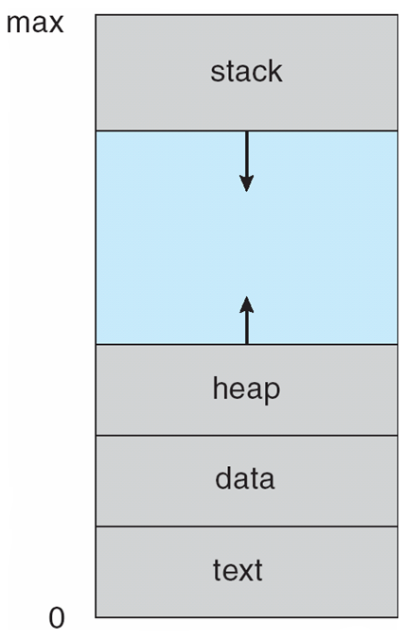
PROCESS IN MEMORY
Fig:- Process in memory
Notes:
In memory, a process consists of multiple parts:
Program code, also called text section
Current activity including
program counter
processor registers
Stack containing temporary data
Function parameters, return addresses, local variables
Data section containing global variables
Heap containing memory dynamically allocated during run time

Slide 5
PROCESS CREATION
Four principal events that causes processes to be
created
System initialization
Execution of a process creation by system call
A user request to create a new process
Initiation of a batch job

Slide 6
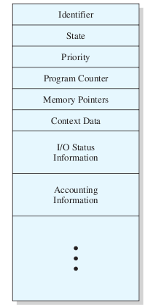
PROCESS CONTROL BLOCK(PCB)
Fig:- Process Control Block
Notes:
Each process is represented by a PCB
Data structure that physically represent a process in memory
Contains information associated with specific process
Identifier:- unique id
State:- among the various states represents the current state
Priority:- priority level relative to other processes
Program counter:- address of next instruction to be executed
Memory pointers:- pointers to the program code and data associated with process
Context data:- data present in registers while process is executing
I/O status information:- I/O requests and I/O devices assigned to the process
Accounting information:- amount of processor time, clock time used etc…

Slide 7
PROCESS TERMINATION
Reasons behind process termination
Voluntary
Normal exit
Error exit
Involuntary
Fatal error
Killed by another process

Slide 8
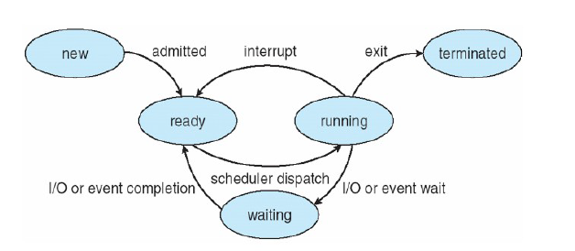
PROCESS STATES
Fig:- Process State Transition Diagram
Notes:
New:- process is being created
Ready:- process is waiting to be assigned to a processor
Running:- instructions are being executed
Waiting:- process is waiting for some event to occur
Terminated:- process has finished execution

Slide 9
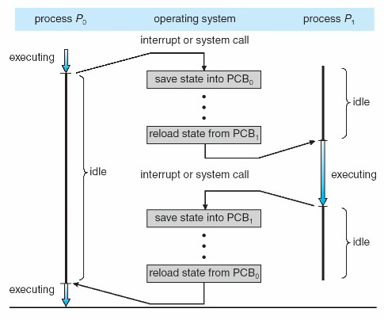
CONTEXT SWITCHING
Fig:- CPU switch from one process to another
Notes:
Switching the CPU to another process requires performing a state save of the
current process and a state restore of a different process. This task is known as context switch.
When a context switch occurs, the kernel saves the context of the old process in its PCB
and loads the saved context of the new process scheduled to run.
Context switch time is pure overhead, because the system does no useful work
while switching.

Slide 10
THREAD
Basic unit of CPU utilization
Comprises of thread ID, program counter, a register
set and a stack
Shares code section, data section and resource with other threads

Slide 11
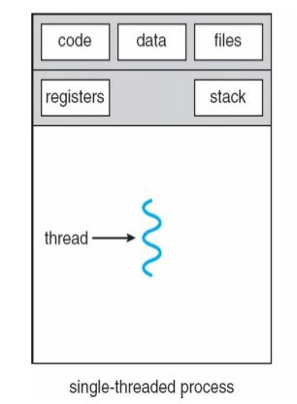
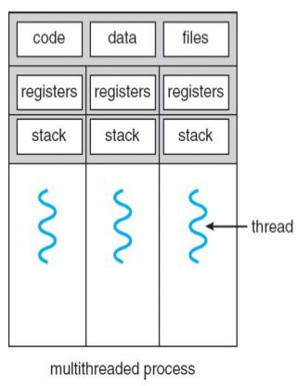
THREAD

Slide 12
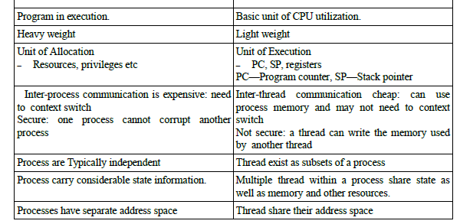

PROCESS VS THREAD
Process
Thread

Slide 13
MULTITHREADING
Why multithreading?
Web server example
Benefits
Responsiveness
Resource Sharing
Economy
Utilization of multiprocessor architecture
Notes:
In certain situations, a single application may be required to perform several similar task such as a web server accepts client requests for web pages, images, sound, graphics etc. A busy web server may have several clients concurrently accessing it. So if the web server runs on traditional single threaded process, it would be able to service only one client at a time. The amount of time that the client might have to wait for its request to be serviced is enormous. One solution of this problem can be thought by creation of new process. When the server receives a new request, it creates a separate process to service that request. But this method is heavy weight. In fact this process creation method was common before threads become popular. Process creation is time consuming and resource intensive. If the new process perform the same task as the existing process, why incur all that overhead? It is generally more efficient for one process that contains multiple threads to serve the same purpose. This approach would multithreaded the web server process. The server would create a separate thread that would listen for clients requests. When a request is made, rather than creating another process, it will create a separate thread to service the request.

Slide 14
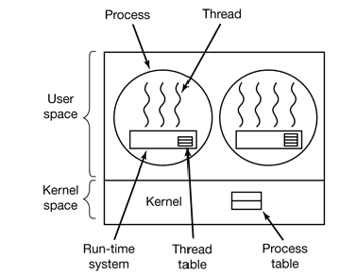
User Space Thread
User managed threads
In this case, the thread management kernel is not aware of the existence of threads
The thread library contains code for creating and destroying threads, for passing message and data between threads, for scheduling thread execution and for saving and restoring thread contexts

Slide 15
Advantages
Thread switching does not require Kernel mode privileges
Can run on any operating system
Scheduling can be application specific
Fast to create and manage
Disadvantages
In a typical operating system, most system calls are blocking
Multithreaded application cannot take advantage of multiprocessing

Slide 16
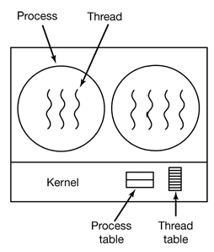
Kernel Space Thread
OS managed threads acting on kernel
No thread management code in the application area
Any application can be programmed to be multithreaded
The Kernel performs thread creation, scheduling and management in Kernel space

Slide 17
Advantages
Kernel can simultaneously schedule multiple threads from the same process on multiple processes
If one thread in a process is blocked, the Kernel can schedule another thread of the same process
Kernel routines themselves can be multithreaded
Disadvantages
Generally slower to create and manage than the user threads
Transfer of control from one thread to another within the same process requires a mode switch to the Kernel

Slide 18
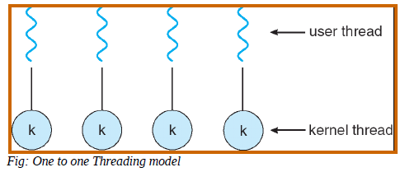
MULTITHREADING MODEL
One-to-One
Notes:
maps each user thread to a kernel thread
another thread can run when a thread makes blocking system call
creating a user thread requires creating corresponding kernel thread

Slide 19
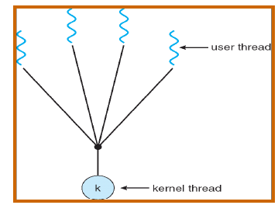
MULTITHREADING MODEL
Many-to-One
Fig:- many-to-one threading model
Notes:
maps user threads to single kernel thread
entire process is blocked when a thread makes blocking system call
one thread can access the kernel at a time

Slide 20
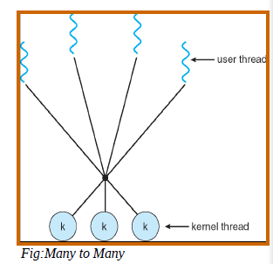
MULTITHREADING MODEL
Many-to-Many
Notes:
multiplexes many user thread to a smaller or equal number of kernel threads
allows user to create as many threads
but kernel can schedule only one thread at a time

Slide 21
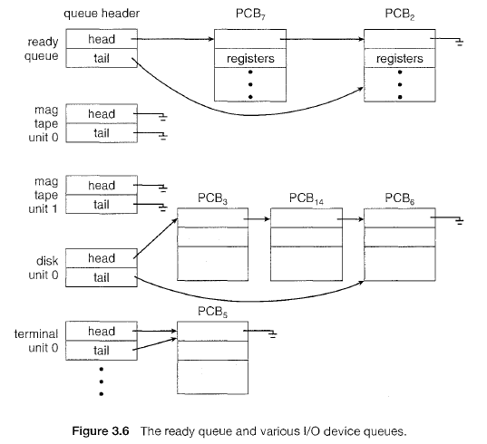
PROCESS SCHEDULING
Scheduling Queues

Slide 22
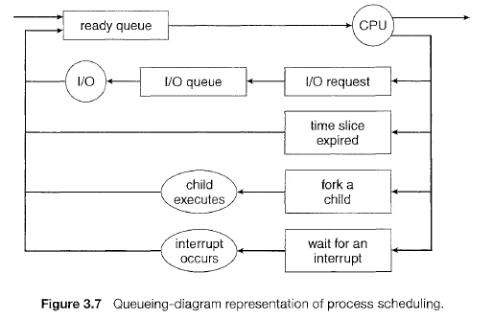
PROCESS SCHEDULING
Queuing Diagram

Slide 23
PROCESS SCHEDULING
Schedulers
Long-term scheduler (or job scheduler)
In a batch system, more processes are submitted than can be
executed in memory
They are spooled to disk
selects which processes should be brought into the ready queue
invoked infrequently
(seconds, minutes) ⇒ (may be slow, hence can use advanced
algorithms)
controls the degree of multiprogramming
The number of processes in memory
Processes can be described as either:
I/O-bound process
Spends more time doing I/O than computations, many
short CPU bursts
CPU-bound process
Spends more time doing computations; few very long
CPU bursts

Slide 24
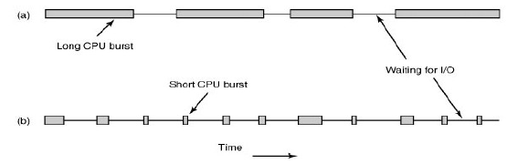
PROCESS BEHAVIOR

Slide 25
PROCESS SCHEDULING
Short-term scheduler (or CPU scheduler)
Selects 1 process to be executed next
Among ready-to-execute processes
Allocates CPU to this process
Sometimes the only scheduler in a system
invoked frequently
(milliseconds) ⇒ (must be fast)
Hence cannot use costly selection logic

Slide 26
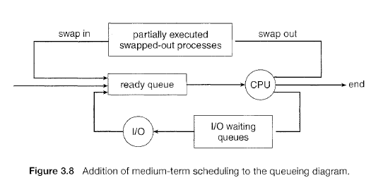
PROCESS SCHEDULING
Medium-term scheduler (or CPU scheduler)
Can be added to decrease degree of multiprogramming
Key idea
Reduce the degree of multiprogramming by swapping
Swapping removes a process from memory, stores on disk, brings back in from disk to continue execution

Slide 27
PROCESS SCHEDULING
Dispatcher
A module that gives control of the CPU to the process selected by short-term scheduler
Functions
Switching context
Switching to user mode
Jumping to proper location in the user program to restart the program
Notes:
The time taken to stop one process and start running another is termed as Dispatch Latency

Slide 28
Circumstances for CPU scheduling decisions
When a process switches from running state to waiting state
When a process switches from running state to ready state
When a process switches from waiting state to ready state
When process terminates
Notes:
Examples
I/O request
Interrupt Occurs
Completion of I/O

Slide 29
PROCESS SCHEDULING
Types of Scheduling
Preemptive Scheduling
Non-Preemptive Scheduling
Criteria for comparison of CPU scheduling algorithms
CPU utilization
Throughput
Turnaround Time
Waiting Time
Response Time

Slide 30
SCHEDULING ALGORITHMS

Slide 31
Categories of Scheduling Algorithms
Batch
Interactive
Real Time

Slide 32
SCHEDULING ALGORITHMS IN BATCH SYSTEM

Slide 33
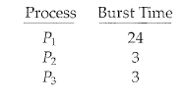


First Come First Serve (FCFS)
Process Order :- P1,P2,P3
Process Order:- P2,P3,P1

Slide 34
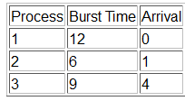
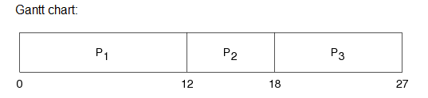

First Come First Serve (FCFS)

Slide 35
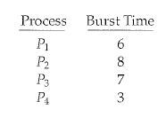


Shortest Job First (SJF)

Slide 36
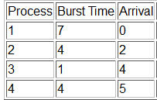
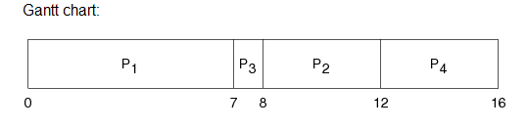

Shortest Job First (SJF)

Slide 37
Process | Burst Time | Arrival Time
A | 15 | 2
B | 4 | 0
C | 10 | 1
D | 8 | 3
Draw the Gantt Chart for above given table using FCFS and SJF process scheduling algorithm and compute average waiting time and average turnaround time.

Slide 38
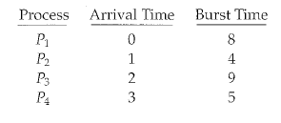


Shortest Remaining Time Next (SRTN) / Preemptive SJF
Notes:
P1 arrives at 0 so it is started
P2 arrives at 1. The remaining time for P1=7 >P2=4
P1 is preempted and P2 is scheduled
Waiting time = [(10-1)+(1-1)+(17-2)+(5-3)]/4= 6.5

Slide 39
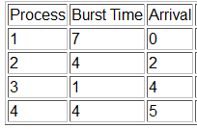
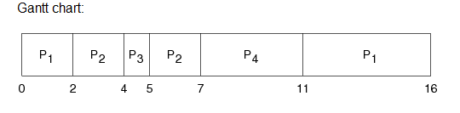

Shortest Remaining Time Next (SRTN) / Preemptive SJF

Slide 40
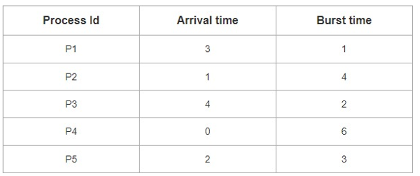
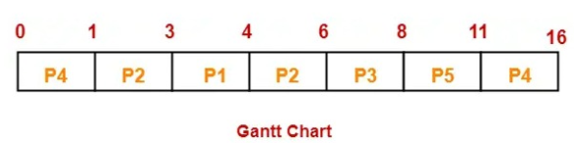

Shortest Remaining Time Next (SRTN) / Preemptive SJF

Slide 41
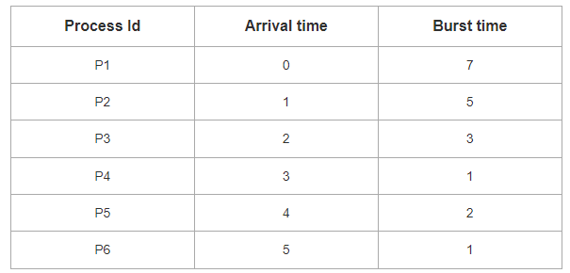
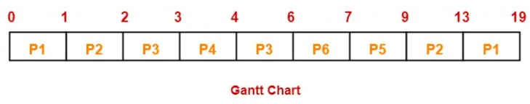

Shortest Remaining Time Next (SRTN) / Preemptive SJF

Slide 42
SCHEDULING ALGORITHMS IN INTERACTIVE SYSTEM

Slide 43
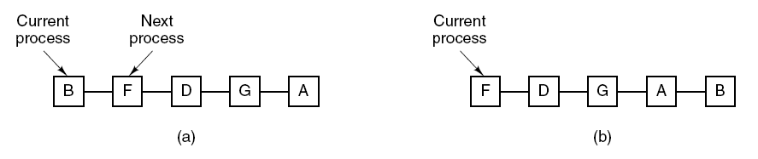
Round Robin (RR) Scheduler
Each process gets a small unit of CPU time (time quantum), usually 10-100 milliseconds
After this time has elapsed, the process is preempted and added to the end of the ready queue
Deciding the length of quantum is subject of research
Fig.:-Round-robin scheduling. (a) The list of runnable processes.
(b) The list of runnable processes after B uses up its quantum

Slide 44
QUANTUM SIZE
If there are n processes in the ready queue and the time quantum is q
Then each process gets 1/n of the CPU time
In chunks of at most q time units at once
No process waits more than (n-1)q time units
Performance
q large ⇒ FCFS, poor response time
q small ⇒ overhead is too high

Slide 45
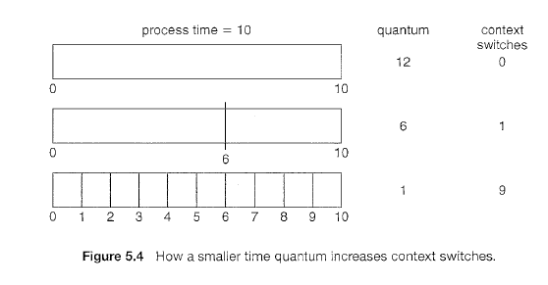

Slide 46



ROUND ROBIN ALGORITHM
quantum (q) = 20
Notes:
Waiting time
P1=0+57+24=81;P2=20;P3=37+40+17 = 94;P4= 57+40 = 97

Slide 47
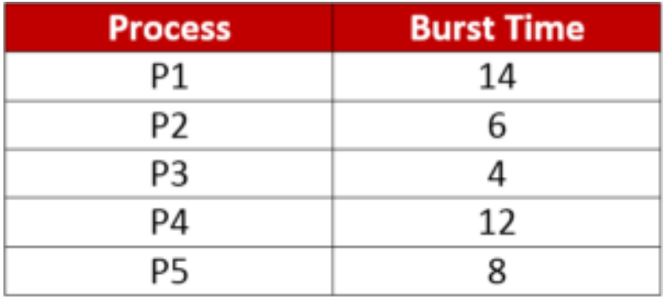

ROUND ROBIN ALGORITHM

Slide 48
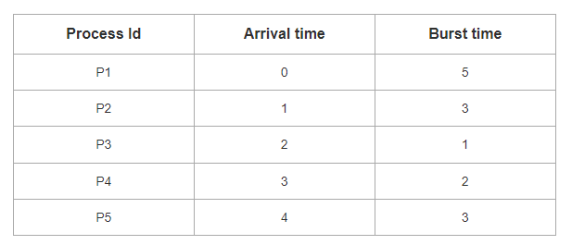
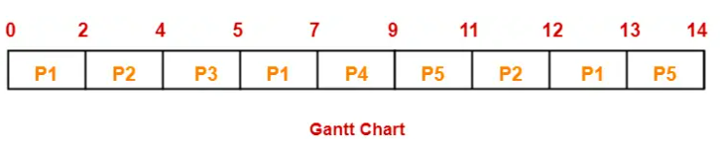

ROUND ROBIN ALGORITHM
Quantum = 2
Notes:
Avg wt = 8.6
Avg tt = 5.8

Slide 49
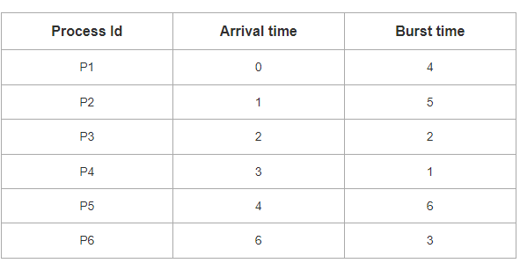
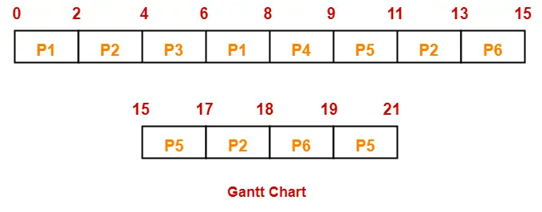

ROUND ROBIN ALGORITHM
Quantum = 2
Notes:
Avg wt = 8.6
Avg tt = 5.8

Slide 50
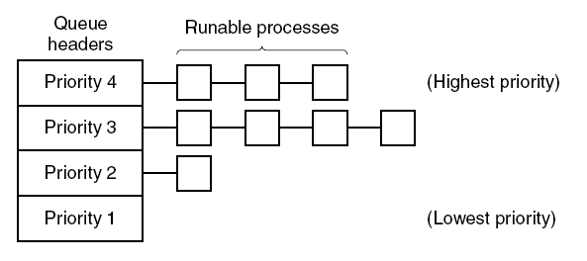
Priority Scheduling Concept

Slide 51
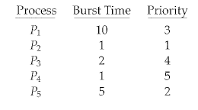

PRIORITY SCHEDULING
Problem
Starvation
Solution
Aging
Notes:
low numbers represent highest priority
Average waiting time = (6+0+16+18+1)/5 = 8.2 milliseconds
Priority scheduling can be either preemptive or non-preemptive.
When a process arrives at the ready queue, its priority is compared with the priority
of the currently running process. A preemptive priority scheduling algorithm
will preempt the CPU if the priority of the newly arrived process is higher
than the priority of the currently running process. A nonpreemptive priority
scheduling algorithm will simply put the new process at the head of the ready
queue.

Slide 52
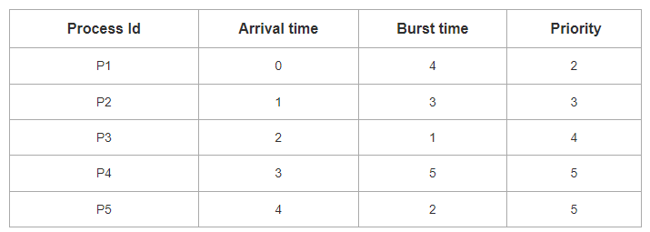
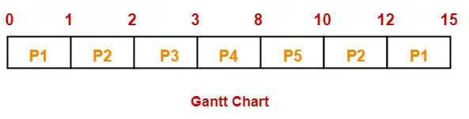

PRIORITY SCHEDULING

Slide 53
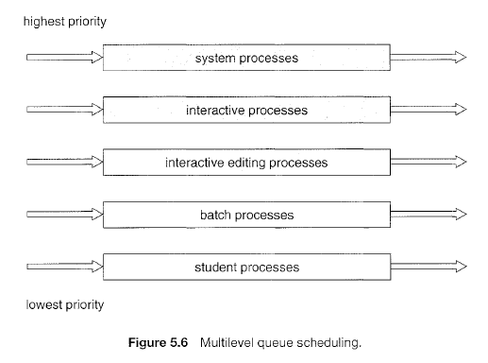
Multilevel Queue Scheduling
Notes:
the ready queue is managed as multiple queues based on various characteristics. For instance,
foreground (interactive)
background (batch)
each queue uses a particular scheduling algorithm. For instance,
foreground (round robin)
background (FCFS)
scheduling must be done between queues:
fixed priority (may lead to starvation) (e.g., foreground jobs have absolute priority over background jobs)
time slice per queue

Slide 54
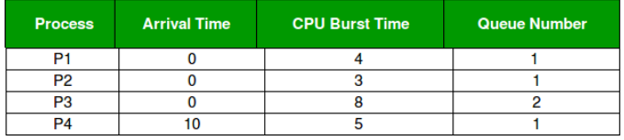
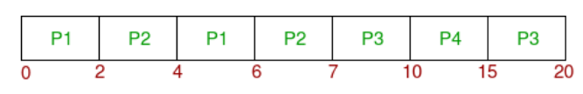
Multilevel Queue Scheduling
Consider below table of four processes under Multilevel queue scheduling. Queue number denotes the queue of the process. Priority of queue 1 is greater than queue 2. Queue 1 uses Round Robin (Time Quantum = 2) and queue 2 uses FCFS.
Gantt Chart
Notes:
Working:
At starting, both queues have process so process in queue 1 (P1, P2) runs first (because of higher priority) in the round robin fashion and completes after 7 units
Then process in queue 2 (P3) starts running (as there is no process in queue 1) but while it is running P4 comes in queue 1 and interrupts P3 and start running for 5 second and
After its completion P3 takes the CPU and completes its execution.

Slide 55
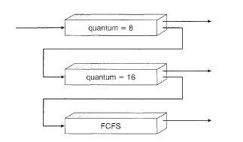
Multilevel Feedback Queue Scheduling
Notes:
For example, consider a multilevel feedback queue scheduler with three queues, numbered from 0 to 2 (Figure 5.7). The scheduler first executes all
processes in queue 0. Only when queue 0 is empty it will execute processes in queue 1. Similarly, processes in queue 2 will only be executed if queues 0
and 1 are empty. A process that arrives for queue 1 will preempt a process in queue 2. A process in queue 1 will in turn be preempted by a process arriving
for queue 0.
A process entering the ready queue is put in queue 0. A process in queue 0 is given a time quantum of 8 milliseconds. If it does not finish within this time,
it is moved to the tail of queue 1. If queue 0 is empty, the process at the head of queue 1 is given a quantum of 16 milliseconds. If it does not complete, it is preempted and is put into queue 2. Processes in queue 2 are run on an FCFS basis but are run only when queues 0 and 1 are empty.

Slide 56
Guaranteed Scheduling
CPU time entitled = Time since creation/n
Ratio = Actual CPU time consumed/ CPU time entitled
Ratio = 0.5[had half of what it should have had]
Ratio = 0.2[had twice as much as it was entitled]
Runs process with lowest ratio until its ratio has moved above its closest competitor
Lottery Scheduling

